Slide 1
TNGS Learning Solutions INTRODUCTION TO AWS

Slide 2
AWS (Amazon Web Services)
Cloud Service Provider
Offers various types of services
IaaS (Infrastructure as a Service)
SaaS (Software as a Service)
PaaS (Platform as a Service)
Leading Cloud Service Providers
Other CSP
GCP → Google Cloud Platform
Azure by Microsoft
Alibaba Cloud

Slide 3
AWS (Amazon Web Services)
In AWS platform, we manage resource in isolated locations referred to as Regions/Data Centers
Most Amazon service are hosted in multiple locations world-wide.
These Service are referred to as Region-Specific Services
These locations are composed of regions and Availability Zones.
Each region is a separate geographic area.
Each region has multiple, isolated locations known as Availability Zones.
This provides you with the ability to place resources, such as instances, and data in multiple locations.
Resources aren’t automatically replicated across regions unless you specify do so.

Slide 4
Region and Availability Zone Relation
Each region is completely independent.
Each Availability Zone is isolated, but the Availability Zones in a region are connected through low-latency links.
The following diagram illustrates the relationship between regions and Availability Zones.

Slide 5
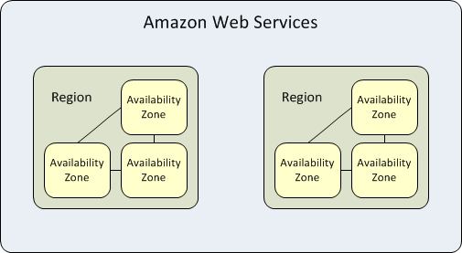
Region and Availability Zone Relation

Slide 6
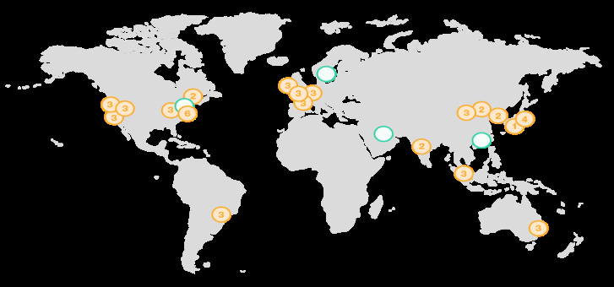
AWS GLOBAL INFRASTRCUTURE
https://aws.amazon.com/about-aws/global-infrastructure/

Slide 7
Five Pillars of Well Architect Solutions in AWS
Operational Excellence
Security
Reliability
Performance
Cost Optimization

Slide 8
THANK YOU

